Slide 1
23AM2403 Database Management System

Slide 2
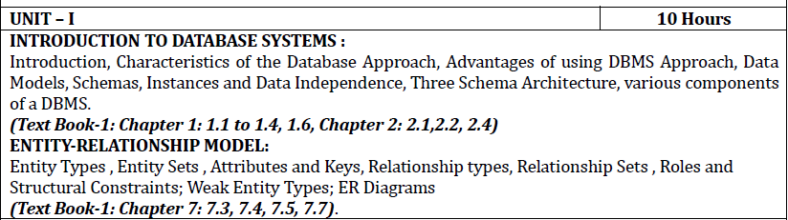
Syllabus

Slide 3
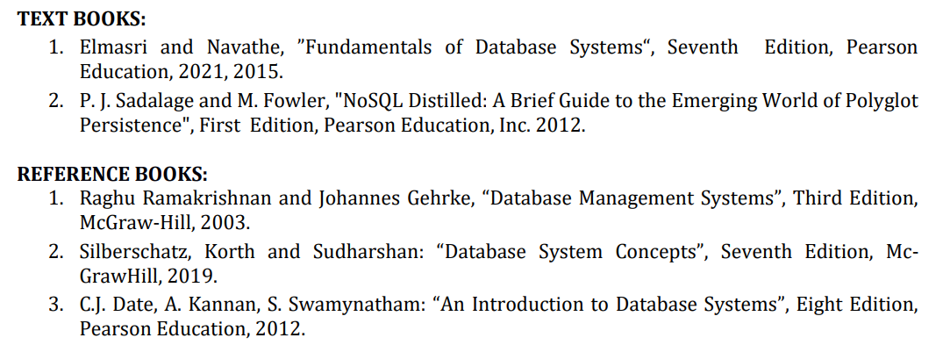
Syllabus

Slide 4
CIE Mark Distribution
Components | Maximum Marks | Reduced To
MSE 1 | 40 | 15
MSE 2 | 40 | 15
AAT | 10 | 10
Lab Exam Writeup – 10 Output – 5 Viva - 5 | 20 | 10
Lab Record | 10 | 10
Total |  | 60

Slide 5
Why DBMS?
A solid understanding of DBMS is crucial as it provides you with essential skills and knowledge needed for effective data management, system design, collaboration, decision support, and overall success in your future engineering careers.

Slide 6
Why DBMS?
Data Management Skills:
Why: Engineering projects involve handling and analyzing large datasets.
How DBMS Helps: DBMS teaches students how to efficiently organize, store, and retrieve data, fostering valuable data management skills.
System Design and Implementation:
Why: Engineers design and implement systems that require effective data storage and retrieval mechanisms.
How DBMS Helps: DBMS principles are fundamental to system design, helping students understand how to structure data for optimal system performance.
Real-world Application:
Why: Practical applications in various engineering fields often involve managing complex datasets.
How DBMS Helps: DBMS provides hands-on experience with real-world applications, preparing students for challenges they may encounter in their engineering careers.

Slide 7
Why DBMS?
Collaboration and Concurrency:
Why: Engineering projects often involve multiple team members working simultaneously.
How DBMS Helps: DBMS teaches students about concurrent access and collaboration, crucial skills for working on team projects and preventing data conflicts.
Decision Support:
Why: Engineers need to make informed decisions based on data analysis.
How DBMS Helps: DBMS facilitates efficient data retrieval and analysis, enabling engineers to make informed decisions supported by accurate and up-to-date information.
Security Awareness:
Why: Protecting sensitive information is critical in engineering projects.
How DBMS Helps: DBMS introduces students to data security concepts, such as access control and encryption, ensuring they understand how to safeguard information.

Slide 8
Why DBMS?
Project Management:
Why: Successful project management involves effective organization and utilization of project data.
How DBMS Helps: DBMS skills contribute to efficient project management by ensuring data integrity, accessibility, and consistency throughout the project lifecycle.
Adaptability to Technology Trends:
Why: The field of database technology evolves rapidly.
How DBMS Helps: Learning DBMS equips engineering students with adaptable skills, allowing them to stay current with emerging database technologies and trends.
Preparation for Specialized Engineering Fields:
Why: Different engineering disciplines, such as civil, electrical, or mechanical, often have unique data requirements.
How DBMS Helps: DBMS education provides a foundation that can be tailored to the specific data needs of various engineering specialties.

Slide 9
Unit 1
INTRODUCTION TO DATABASE SYSTEMS :
Introduction, Characteristics of the Database Approach, Advantages of using DBMS Approach, Data Models, Schemas, Instances and Data Independence, Three Schema Architecture, various components of a DBMS.
ENTITY-RELATIONSHIP MODEL:
Entity Types , Entity Sets , Attributes and Keys, Relationship types, Relationship Sets , Roles and Structural Constraints; Weak Entity Types; ER Diagrams

Slide 10
Basic Definitions
Database:
A collection of related data.
Data:
Known facts that can be recorded and have an implicit meaning.
Database Management System (DBMS):
A software package/ system to facilitate the creation and maintenance of a computerized database.
Database System:
The DBMS software together with the data itself. Sometimes, the applications are also included.

Slide 11









Popular DBMSs

Slide 12
Introduction
Implicit properties:
A database represents some aspect of the real world, sometimes called the miniworld or the universe of discourse (UoD). Changes to the miniworld are reflected in the database.
A database is a logically coherent collection of data with some inherent meaning. A random assortment of data cannot correctly be referred to as a database.
A database is designed, built, and populated with data for a specific purpose. It has an intended group of users and some preconceived applications in which these users are interested.
Notes:
Databases and database technology have had a major impact on the growing use of computers. It is fair to say that databases play a critical role in almost all areas where computers are used, including business, electronic commerce, social media, engineering, medicine, genetics, law, education, and library science. The word database is so commonly used that we must begin by defining what a database is. Our initial definition is quite general.

Slide 13
Introduction
A database can be of any size and complexity.
A database may be generated and maintained manually or it may be computerized.
Defining a database involves specifying the data types, structures, and constraints of the data to be stored in the database.
Notes:
For example, the list of names and addresses referred to earlier may consist of only a few hundred records, each with a simple structure.. An example of a large commercial database is Amazon.com.

Slide 14
Introduction
The DBMS is a general-purpose software system that facilitates the processes of defining, constructing, manipulating, and sharing databases among various users and applications.
The database definition or descriptive information is also stored by the DBMS in the form of a database catalog or dictionary; it is called meta-data.
Constructing the database is the process of storing the data on some storage medium that is controlled by the DBMS.

Slide 15
Introduction
Manipulating a database includes functions such as querying the database to retrieve specific data, updating the database to reflect changes in the miniworld, and generating reports from the data.
Sharing a database allows multiple users and programs to access the database simultaneously.
An application program accesses the database by sending queries or requests for data to the DBMS.
A query typically causes some data to be retrieved; a transaction may cause some data to be read and some data to be written into the database.

Slide 16
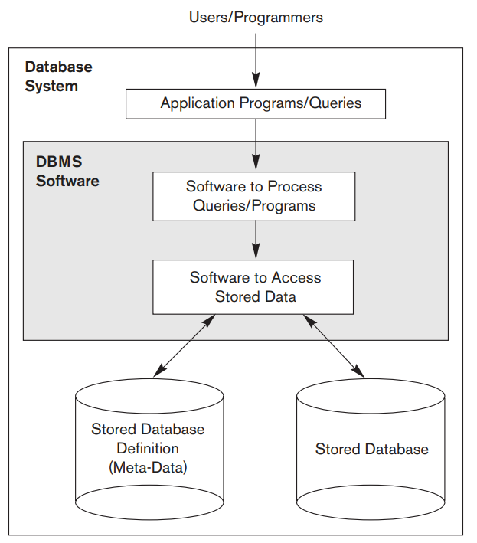
Introduction
A simplified database system environment.

Slide 17
Introduction
Additional DBMS Functionality
DBMS may additionally provide:
Protection or Security measures to prevent unauthorized access
“Active” processing to take internal actions on data
Presentation and Visualization of data
Maintenance of the database and associated programs over the lifetime of the database application
Called database, software, and system maintenance

Slide 18
Example
Mini-world for the example:
Part of a UNIVERSITY environment.
Some mini-world entities:
STUDENTs
COURSEs
SECTIONs (of COURSEs)
(academic) DEPARTMENTs
INSTRUCTORs

Slide 19
Example
Some mini-world relationships:
SECTIONs are of specific COURSEs
STUDENTs take SECTIONs
COURSEs have prerequisite COURSEs
INSTRUCTORs teach SECTIONs
COURSEs are offered by DEPARTMENTs
STUDENTs major in DEPARTMENTs

Slide 20
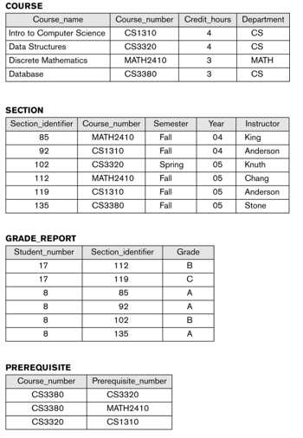
Example

Slide 21
Quiz
Which of the following is NOT a key component of a typical DBMS architecture?
A) Database
B) Application Programs
C) Computer Hardware
D) Users

Slide 22
Quiz
Which of the following is NOT a key component of a typical DBMS architecture?
A) Database
B) Application Programs
C) Computer Hardware
D) Users

Slide 23
Quiz
What is the role of metadata in a database, and how does it contribute to effective data management?
A) Metadata is irrelevant to database management.
B) Metadata provides security for the database.
C) Metadata describes and provides information about data in the database.
D) Metadata is primarily used for data encryption.

Slide 24
Quiz
What is the role of metadata in a database, and how does it contribute to effective data management?
A) Metadata is irrelevant to database management.
B) Metadata provides security for the database.
C) Metadata describes and provides information about data in the database.
D) Metadata is primarily used for data encryption.

Slide 25
Characteristics of the Database Approach
The main characteristics of the database approach versus the file-processing approach
Self-describing nature of a database system
Insulation between programs and data, and data abstraction
Support of multiple views of the data
Sharing of data and multiuser transaction processing

Slide 26
Characteristics of the Database Approach
Self-describing nature of a database system:
A DBMS catalog stores the description of a particular database (e.g. data structures, types, and constraints)
The description is called meta-data*.
This allows the DBMS software to work with different database applications.
Insulation between programs and data:
Called program-data independence.
Allows changing data structures and storage organization without having to change the DBMS access programs.
* Some newer systems such as a few NOSQL systems need no meta-data: they store the data definition within its structure making it self describing

Slide 27
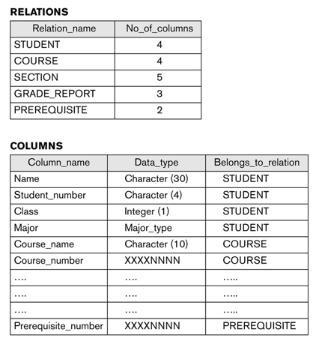
Characteristics of the Database Approach
Catalog for University Database

Slide 28
Characteristics of the Database Approach
Data Abstraction:
A data model is used to hide storage details and present the users with a conceptual view of the database.
Programs refer to the data model constructs rather than data storage details
Support of multiple views of the data:
Each user may see a different view of the database, which describes only the data of interest to that user.

Slide 29
Characteristics of the Database Approach
Sharing of data and multi-user transaction processing:
Allowing a set of concurrent users to retrieve from and to update the database.
Concurrency control within the DBMS guarantees that each transaction is correctly executed or aborted
Recovery subsystem ensures each completed transaction has its effect permanently recorded in the database
OLTP (Online Transaction Processing) is a major part of database applications. This allows hundreds of concurrent transactions to execute per second.

Slide 30
Quiz
What is a key characteristic of the Database Approach?
A) Redundancy
B) Data Independence
C) Limited Storage
D) No Relationships

Slide 31
Quiz
What is a key characteristic of the Database Approach?
A) Redundancy
B) Data Independence
C) Limited Storage
D) No Relationships

Slide 32
Quiz
Why is data redundancy considered a disadvantage in traditional file processing systems?
A) It simplifies data retrieval
B) It reduces storage space
C) It may lead to inconsistencies and errors
D) It improves data security

Slide 33
Quiz
Why is data redundancy considered a disadvantage in traditional file processing systems?
A) It simplifies data retrieval
B) It reduces storage space
C) It may lead to inconsistencies and errors
D) It improves data security

Slide 34
Advantages of Using DBMS Approach
Controlling Redundancy
Redundancy - storing the same data multiple times. Leads to duplication of effort, storage space waste, inconsistency,.
In the database approach, the views of different user groups are integrated during database design.
Stores each logical data item in only one place in the database.
Data normalization - ensures consistency and saves storage space

Slide 35
Advantages of Using DBMS Approach
Restricting Unauthorized Access
A DBMS should provide a security and authorization subsystem.
Providing Persistent Storage for Program Objects
Databases can be used to provide persistent storage for program objects and data structures. This is one of the main reasons for object-oriented database systems
Providing Storage Structures and Search Techniques for Efficient Query Processing
Database systems must provide capabilities for efficiently executing queries and updates. Example – Indexes, buffering or caching module, query processing and optimization module

Slide 36
Advantages of Using DBMS Approach
Providing Backup and Recovery
A DBMS must provide facilities for recovering from hardware or software failures.
Providing Multiple User Interfaces
Because many types of users with varying levels of technical knowledge use a database, a DBMS should provide a variety of user interfaces.
Representing Complex Relationships among Data
A DBMS must have the capability to represent a variety of complex relationships among the data, to define new relationships as they arise, and to retrieve and update related data easily and efficiently.
Enforcing Integrity Constraints
Referential integrity constraint, key or uniqueness constraint

Slide 37
Advantages of Using DBMS Approach
Permitting Inferencing and Actions Using Rules and Triggers
Deductive database systems - provide capabilities for defining deduction rules for inferencing new information from the stored database facts.
A trigger is a form of a rule activated by updates to the table, which results in performing some additional operations to some other tables, sending messages, and so on.
More involved procedures to enforce rules are popularly called stored procedures;

Slide 38
Advantages of Using DBMS Approach
Additional Implications of Using the Database Approach
Potential for enforcing standards:
This is very crucial for the success of database applications in large organizations. Standards refer to data item names, display formats, screens, report structures, meta-data (description of data), Web page layouts, etc.
Reduced application development time:
Incremental time to add each new application is reduced.

Slide 39
Advantages of Using DBMS Approach
Additional Implications of Using the Database Approach
Flexibility to change data structures:
Database structure may evolve as new requirements are defined.
Availability of current information:
Extremely important for on-line transaction systems such as shopping, airline, hotel, car reservations.
Economies of scale:
Wasteful overlap of resources and personnel can be avoided by consolidating data and applications across departments.

Slide 40
Quiz
What is a primary advantage of using a DBMS in a business environment?
A) Decreased data security
B) Limited data accessibility
C) Improved data organization
D) Reduced scalability

Slide 41
Quiz
What is a primary advantage of using a DBMS in a business environment?
A) Decreased data security
B) Limited data accessibility
C) Improved data organization
D) Reduced scalability

Slide 42
Quiz
How does a DBMS contribute to data security in comparison to traditional file systems?
A) It exposes data to external threats
B) It lacks authentication mechanisms
C) It provides access control and authentication features
D) It stores data in plain text

Slide 43
Quiz
How does a DBMS contribute to data security in comparison to traditional file systems?
A) It exposes data to external threats
B) It lacks authentication mechanisms
C) It provides access control and authentication features
D) It stores data in plain text

Slide 44
Data Models
Data Model:
A set of concepts to describe the structure of a database, the operations for manipulating these structures, and certain constraints that the database should obey.
Data Model Structure and Constraints:
Constructs are used to define the database structure
Constructs typically include elements (and their data types) as well as groups of elements (e.g. entity, record, table), and relationships among such groups
Constraints specify some restrictions on valid data; these constraints must be enforced at all times

Slide 45
Data Models
Types of Data Models in DBMS
Hierarchical Model
Network Model
Entity-Relationship Model
Relational Model
Object-Oriented Data Model
Object-Relational Data Model
Flat Data Model
Semi-Structured Data Model
Associative Data Model
Context Data Model

Slide 46
Data Models
Entity-Relationship Model (ER Model)
An Entity-Relationship model is a high-level data model that describes the structure of the database in a pictorial form which is known as ER-diagram.
In simple words, an ER diagram is used to represent logical structure of the database easily.

Slide 47
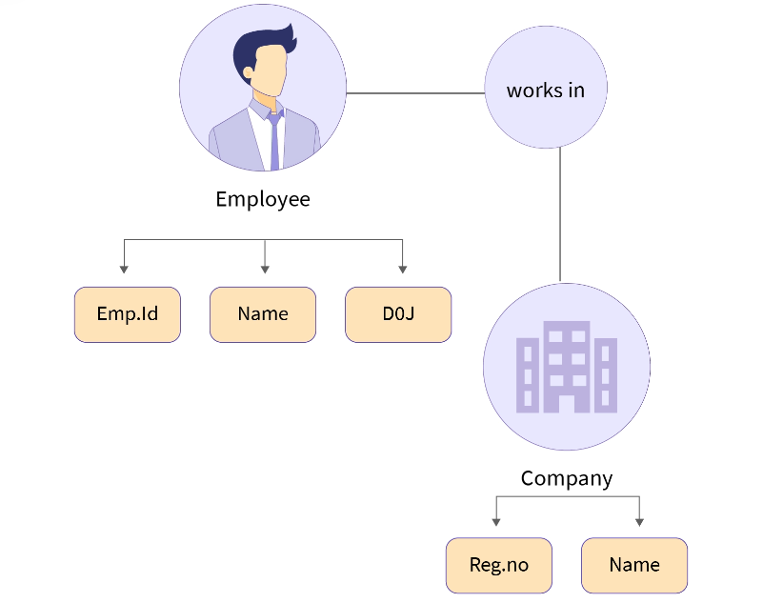
Data Models
Entity-Relationship Model (ER Model)

Slide 48
Data Models
Relational Model
This is the most widely accepted data model. In this model, the database is represented as a collection of relations in the form of rows and columns of a two-dimensional table. Each row is known as a tuple (a tuple contains all the data for an individual record) while each column represents an attribute.

Slide 49
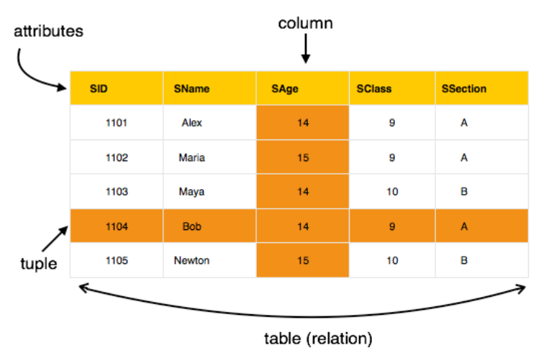
Data Models
Relational Model

Slide 50
Data Models
Object-Oriented Data model
As suggested by its name, the object-oriented data model is a combination of object-oriented programming and relational data model. In this data model, the data and their relationship are represented in a single structure which is known as an object.
Since data is stored as objects we can easily store audio, video, images, etc in the database which was very difficult and inconvenient to do in the relational model. As shown in the image below two objects are connected with each other through links.

Slide 51
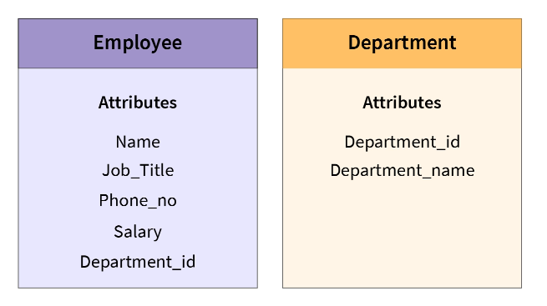
Data Models
Object-Oriented Data model

Slide 52
Data Models
Semi-Structured Data Model
A semi-structured data model is a generalized form of the relational model, which allows representing data in a flexible way, hence we can not differentiate between data and schema in this model because, in this model, some entities have a missing attribute(s) and on the other hand, some entities might have some extra attribute(s) which in turn makes it easy to update the schema of the database.
For example - We can say a data model is semi-structured if in some attributes we are storing both atomic values (values that can't be divided further, for example, Roll_No) as well as a collection of values.

Slide 53
Data Models
Hierarchical Model
The hierarchical data model is one of the oldest data models, developed in the 1950s by IBM.
In this data model, the data is organized in a hierarchical tree-like structure.
This data model can be easily visualized because each record in DBMS has one parent and many children (possibly 0)

Slide 54
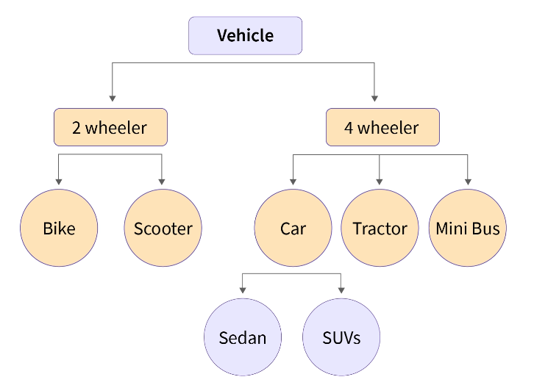
Data Models
Hierarchical Model

Slide 55
Data Models
Network Model
A network model is nothing but a generalization of the hierarchical data model as this data model allows many to many relationships therefore in this model a record can also have more than one parent.
The network model in DBMS can be represented as a graph and hence it replaces the hierarchical tree with a graph in which object types are the nodes and relationships are the edges.

Slide 56
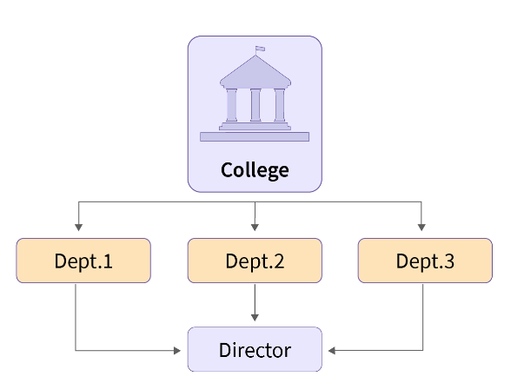
Data Models
Network Model

Slide 57
Data Models
Data Model Operations:
These operations are used for specifying database retrievals and updates by referring to the constructs of the data model.
Operations on the data model may include basic model operations (e.g. generic insert, delete, update) and user-defined operations (e.g. compute_student_gpa, update_inventory)

Slide 58
Data Models
Categories
Conceptual (high-level, semantic) data models:
Provide concepts that are close to the way many users perceive data.
(Also called entity-based or object-based data models.)
Physical (low-level, internal) data models:
Provide concepts that describe details of how data is stored in the computer. These are usually specified in an ad-hoc manner through DBMS design and administration manuals
Implementation (representational) data models:
Provide concepts that fall between the above two, used by many commercial DBMS implementations (e.g. relational data models used in many commercial systems).
Self-Describing Data Models:
Combine the description of data with the data values. Examples include XML, key-value stores and some NOSQL systems.

Slide 59
Quiz
What is the purpose of a data model in database management?
A) To design user interfaces
B)To create visualizations
C) To represent the structure and relationships of data
D) To manage computer hardware

Slide 60
Quiz
What is the purpose of a data model in database management?
A) To design user interfaces
B)To create visualizations
C) To represent the structure and relationships of data
D) To manage computer hardware

Slide 61
Schema
Database Schema:
The description of a database.
Includes descriptions of the database structure, data types, and the constraints on the database.
Schema Diagram:
An illustrative display of (most aspects of) a database schema.
Schema Construct:
A component of the schema or an object within the schema, e.g., STUDENT, COURSE.

Slide 62
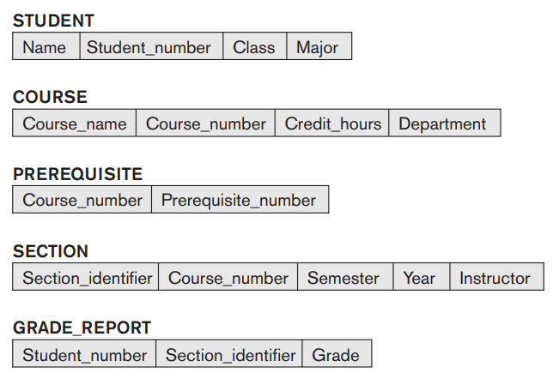
Schema
Schema Diagram

Slide 63
Quiz
What is the primary purpose of a database schema?
A) To execute SQL queries
B) To secure the database
C) To define the structure of the database
D) To create graphical user interfaces

Slide 64
Quiz
What is the primary purpose of a database schema?
A) To execute SQL queries
B) To secure the database
C) To define the structure of the database
D) To create graphical user interfaces

Slide 65
Instance
Database State:
The actual data stored in a database at a particular moment in time. This includes the collection of all the data in the database.
Also called database instance (or occurrence or snapshot).
The term instance is also applied to individual database components, e.g. record instance, table instance, entity instance

Slide 66
Data Independence
The capacity to change the schema at one level of a database system without having to change the schema at the next higher level.
Logical Data Independence:
The capacity to change the conceptual schema without having to change the external schemas and their associated application programs.
Physical Data Independence:
The capacity to change the internal schema without having to change the conceptual schema.
For example, the internal schema may be changed when certain file structures are reorganized or new indexes are created to improve database performance

Slide 67
Data Independence
When a schema at a lower level is changed, only the mappings between this schema and higher- level schemas need to be changed in a DBMS that fully supports data independence.
The higher-level schemas themselves are unchanged.
Hence, the application programs need not be changed since they refer to the external schemas.

Slide 68
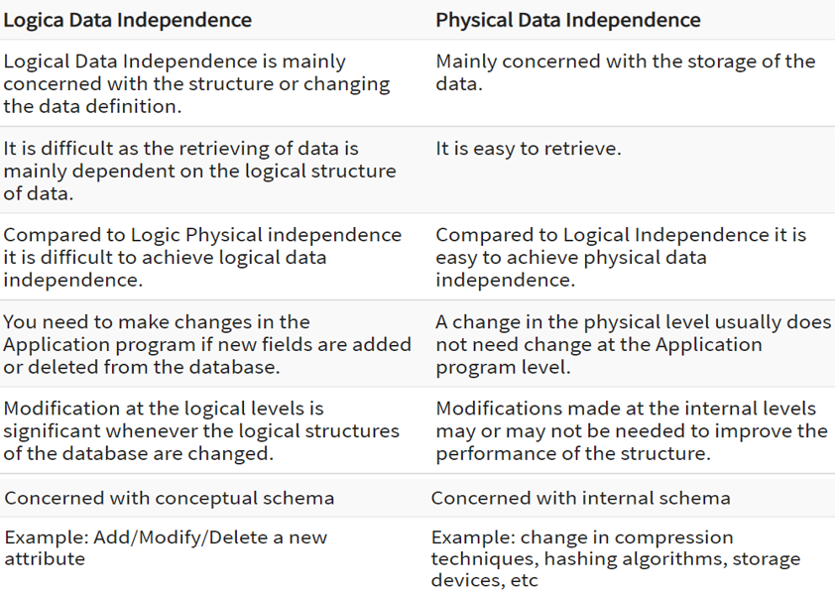
Data Independence

Slide 69
Quiz
What does the term "data independence" refer to in the context of a Database Management System (DBMS)?
A) The ability to store data in an independent format
B) The dependence of data on external sources
C) The separation of data from the application programs
D) The integration of data with the operating system

Slide 70
Quiz
What does the term "data independence" refer to in the context of a Database Management System (DBMS)?
A) The ability to store data in an independent format
B) The dependence of data on external sources
C) The separation of data from the application programs
D) The integration of data with the operating system

Slide 71
Quiz
How does data independence contribute to the flexibility of a database system?
A) It simplifies data retrieval
B) It enables dynamic data encryption
C) It allows changes to the data structure without affecting applications
D) It reduces the need for data normalization

Slide 72
Quiz
How does data independence contribute to the flexibility of a database system?
A) It simplifies data retrieval
B) It enables dynamic data encryption
C) It allows changes to the data structure without affecting applications
D) It reduces the need for data normalization

Slide 73
Three-Schema Architecture
Proposed to support DBMS characteristics of:
Program-data independence.
Support of multiple views of the data.
Not explicitly used in commercial DBMS products, but has been useful in explaining database system organization

Slide 74
Three-Schema Architecture
Defines DBMS schemas at three levels:
Internal schema at the internal level to describe physical storage structures and access paths (e.g indexes).
Typically uses a physical data model.
Conceptual schema at the conceptual level to describe the structure and constraints for the whole database for a community of users.
Uses a conceptual or an implementation data model.
External schemas at the external level to describe the various user views.
Usually uses the same data model as the conceptual schema.

Slide 75
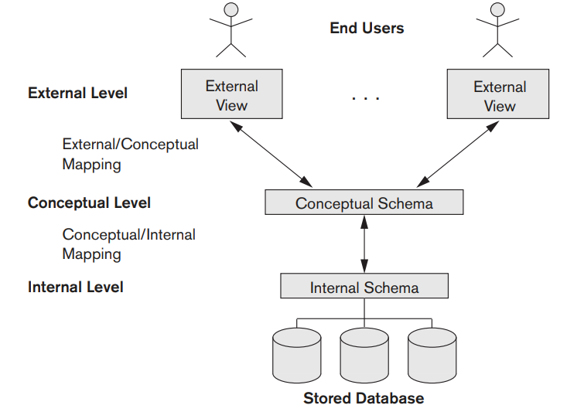
Three-Schema Architecture

Slide 76
Three-Schema Architecture
Mappings among schema levels are needed to transform requests and data.
Programs refer to an external schema, and are mapped by the DBMS to the internal schema for execution.
Data extracted from the internal DBMS level is reformatted to match the user’s external view (e.g. formatting the results of an SQL query for display in a Web page)

Slide 77
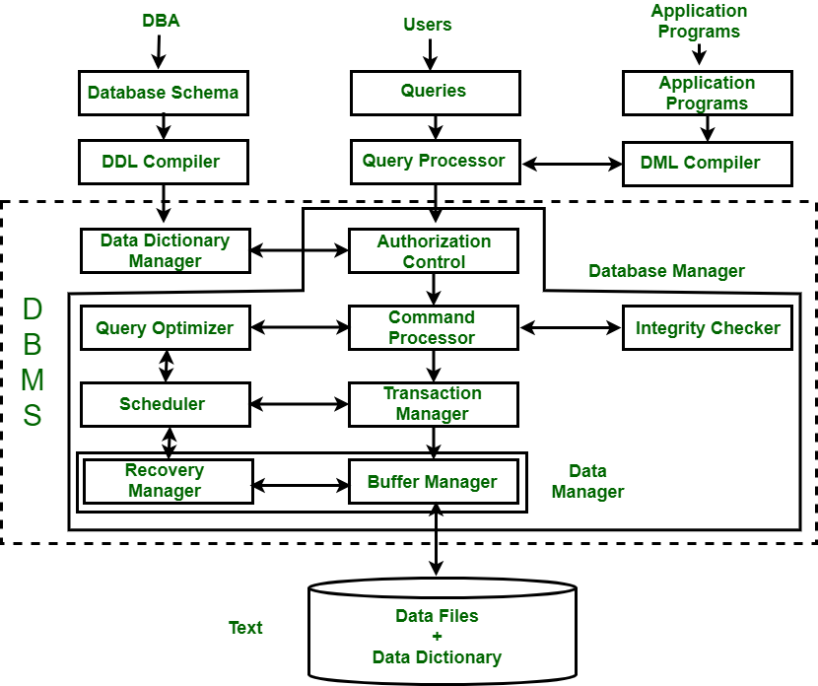
Various Components of a DBMS

Slide 78
Various Components of a DBMS
A Database Management System (DBMS) is software that allows users to define, store, maintain, and manage data in a structured and efficient manner.
It acts as an intermediary between data and users, allowing disparate data from different applications to be managed.
A DBMS simplifies the complexity of data processing by providing tools to organize data, ensure its integrity, and prevent unauthorized access or loss of data.
In today’s data-driven world, DBMS are essential for applications such as banking systems, e-commerce platforms, education, and medical systems.
They not only store and manage large amounts of data, but also provide functionality that provides performance, security, and scalability for multiple users with multiple access levels.

Slide 79
Various Components of a DBMS
It also allows access to data stored in a database and provides an easy and effective method of –
Defining the information.
Storing the information.
Manipulating the information.
We are protecting the information from system crashes or data theft.
Differentiating access permissions for different users.

Slide 80
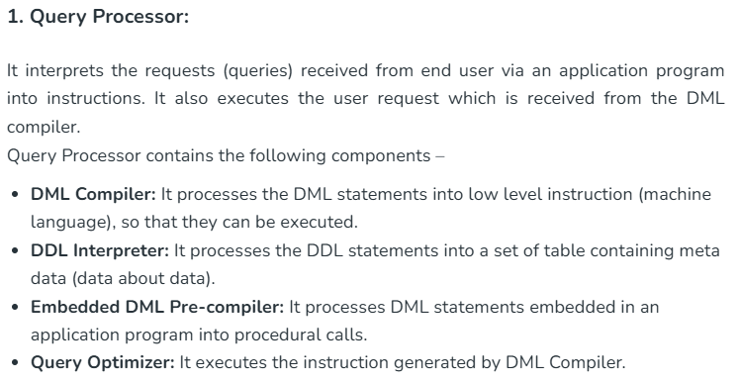
Various Components of a DBMS

Slide 81
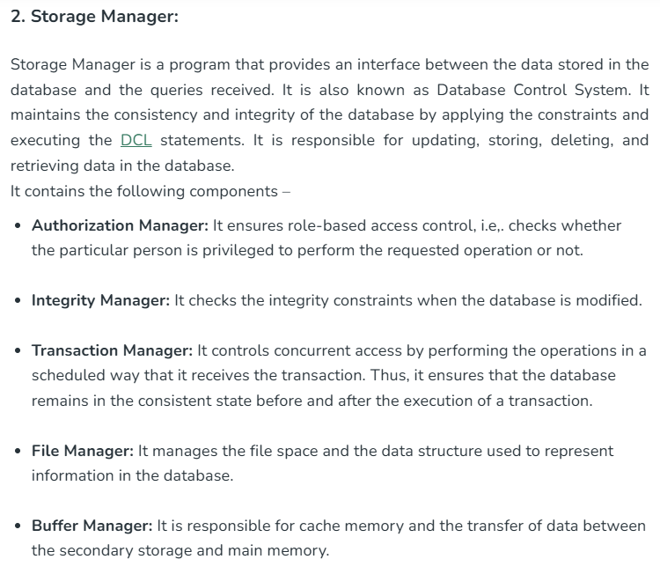
Various Components of a DBMS

Slide 82
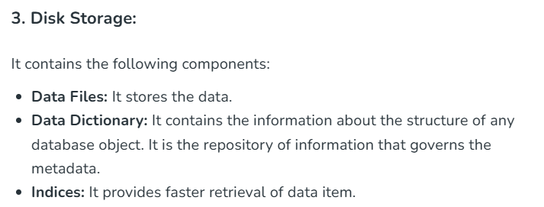
Various Components of a DBMS

Slide 83
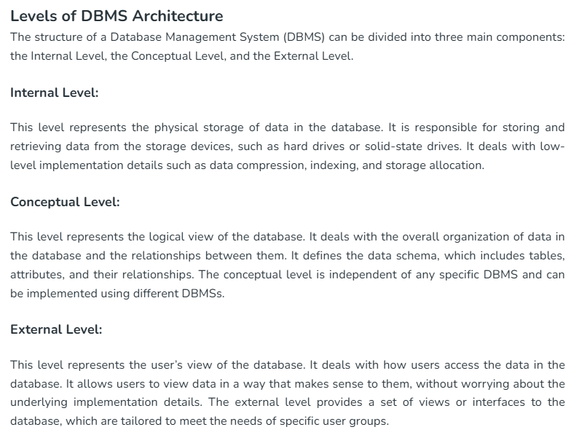
Various Components of a DBMS

Slide 84
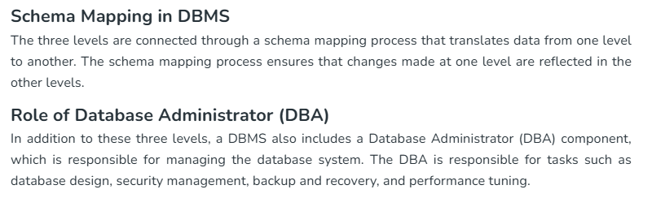
Various Components of a DBMS

Slide 85
Entity Relationship Model
ER model develops a conceptual view of the data hence it can be used as a blueprint to implement the database in the future.
Developers can easily understand the system just by looking at ER diagram.
Components of an ER diagram.
Entity - Anything that has an independent existence about which we collect the data. To learn more about Entity in DBMS click here.
They are represented as rectangles in the ER diagram. For example - Car, house, employee.
Entity Set - A set of the same type of entities is known as an entity set. For example - Set of students studying in a college.
Attributes - Properties that define entities are called attributes. They are represented by an ellipse shape.
Relationships - A relationship in DBMS is used to describe the association between entities. They are represented as diamond or rhombus shapes in the ER diagram.

Slide 86
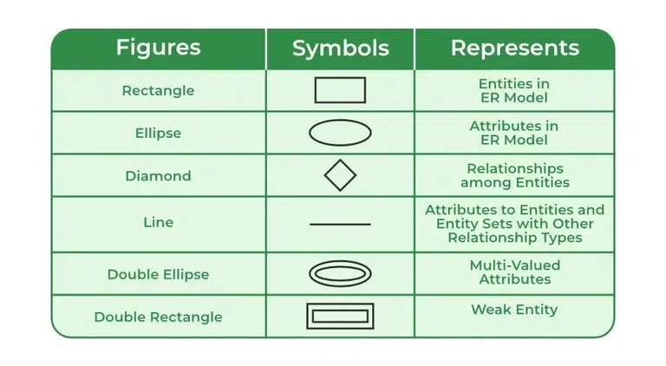

Slide 87
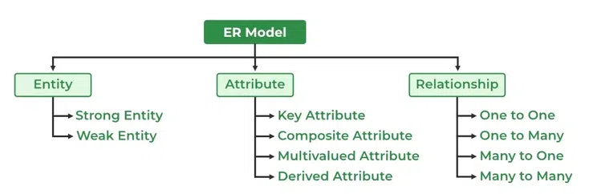

Slide 88
Entity Types
A database can be modeled as:
a collection of entities,
relationship among entities.
Entity : An entity is an object that exists and is distinguishable from other objects.
Example: specific person, company, event, course.

Slide 89
Entity Sets
The collection of all entities of a particular entity type in the database at any point in time is called an entity set or entity collection; the entity set is usually referred to using the same name as the entity type, even though they are two separate concepts.

Slide 90
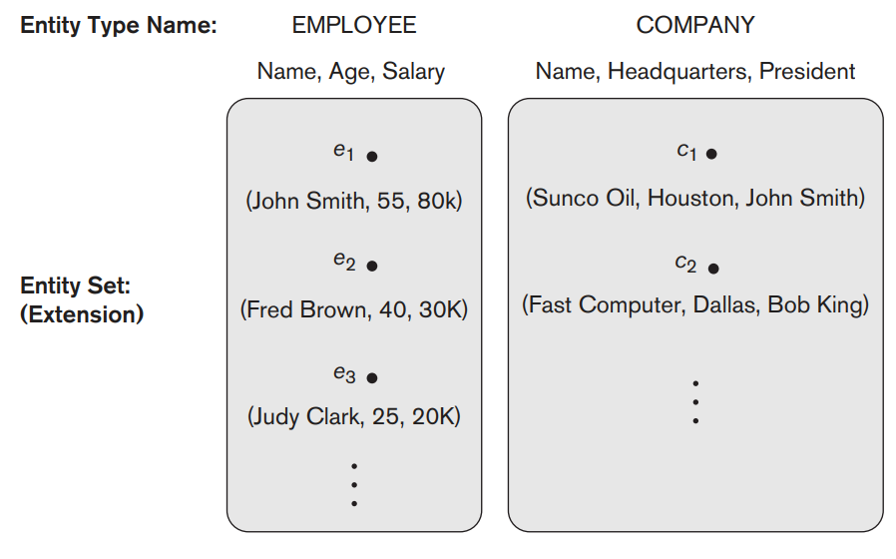
Entity Sets
Two entity types, EMPLOYEE and COMPANY, and some member entities of each.

Slide 91
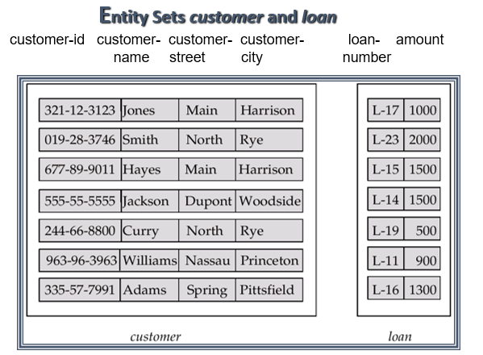
Entity Sets

Slide 92
Attributes
Entities have attributes
Example: people have names and addresses
Attributes : Attributes are characteristics of entity.
Example:
Student Attributes : roll no , studentname
Project Attributes : projectno , projectname ,Dept.

Slide 93
Attributes
An entity is represented by a set of attributes, that is descriptive properties possessed by all members of an entity set.
Example:
1) customer = (customer-id, customer-name, customer-street, customer-city)
2) loan = (loan-number, amount)

Slide 94
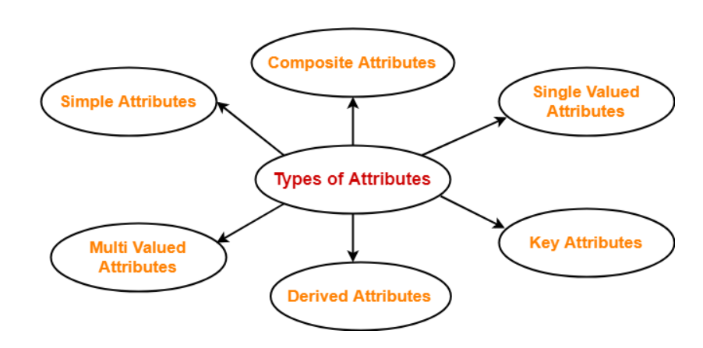
Attributes

Slide 95
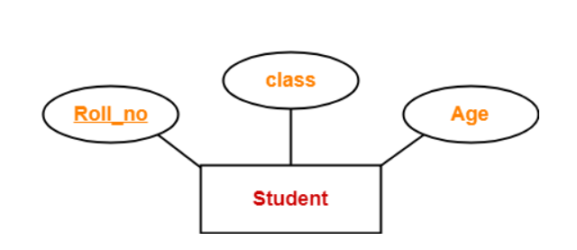
Attributes
Simple Attribute
Simple attributes are those that are atomic (Not Divisible).
Example: Roll_no, Class and Age.

Slide 96
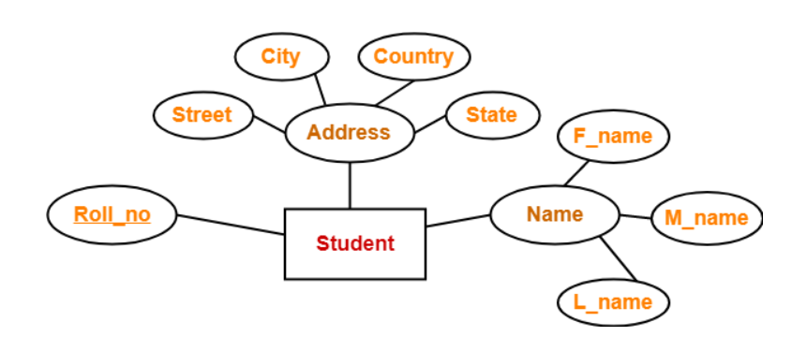
Attributes
Composite Attributes
Composite attributes are those that can be further subdivided into simpler parts. Here, the attributes “Name” and “Address” are composite attributes as they are composed of many other simple attributes.

Slide 97
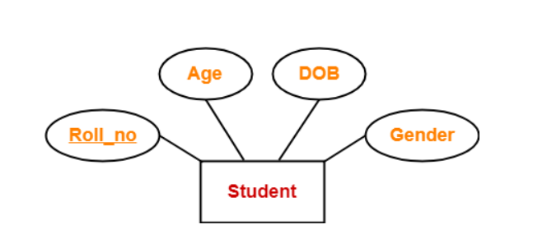
Attributes
Single Valued Attribute
Single valued attributes are those attributes which can take only one value for a given entity from an entity set.
Here, all the attributes are single valued attributes as they can take only one specific value for each entity.

Slide 98
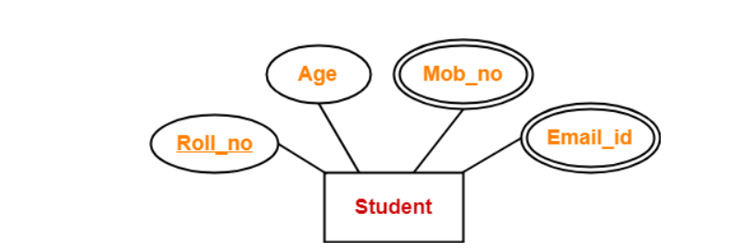
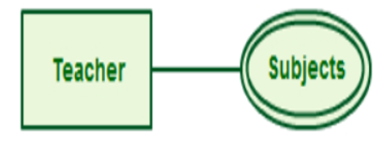
Attributes
Multi-Valued Attributes
Multi valued attributes are those attributes which can take more than one value for a given entity from an entity set.
Here, the attributes “Mob_no” and “Email_id” are multi valued attributes as they can take more than one values for a given entity.

Slide 99
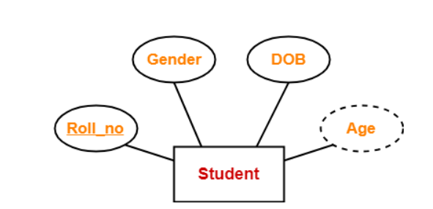
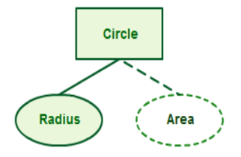
Attributes
Derived Attributes
Derived attributes are those attributes which can be derived from other attribute(s).
Here, the attribute “Age” is a derived attribute as it can be derived from the attribute “DOB”.

Slide 100
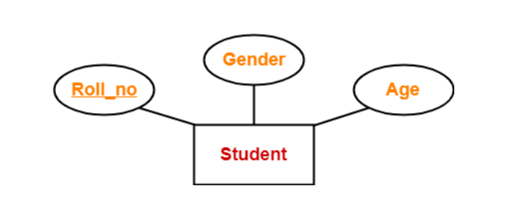
Attributes
Key Attributes
Key attributes are those attributes which can identify an entity uniquely in an entity set.
Here, the attribute “Roll_no” is a key attribute as it can identify any student uniquely.

Slide 101
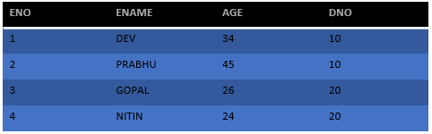
Attributes
Domain:
Domain of an attribute is the set of all values that the attribute can take.
Ex : AGE of an employee can take values from 20 to 60 .
Domain set of AGE attribute for the employee is {20,21. …. 59,60}.
Entity - EMPLOYEE
Attributes - ENO,ENAME,AGE,DNO
Domain of AGE - {34,45,26,24}

Slide 102
Relationship Types and Sets
A relationship type R among n entity types E₁, E₂, . . . , E_{n} defines a set of associations—or a relationship set—among entities from these entity types.
Similar to the case of entity types and entity sets, a relationship type and its corresponding relationship set are customarily referred to by the same name, R.
Mathematically, the relationship set R is a set of relationship instances r_{i}, where each r_{i} associates n individual entities (e₁, e₂, . . . , e_{n}), and each entity e_{j} in r_{i} is a member of entity set E_{j} , 1 ≤ j ≤ n.

Slide 103
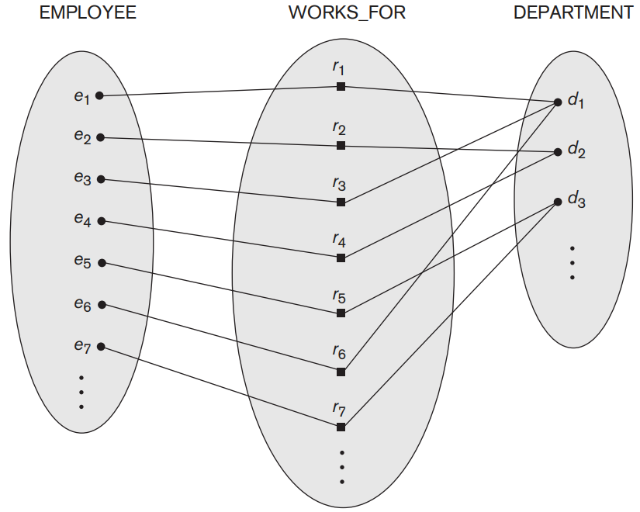
Relationship Types and Sets
Some instances in the WORKS_FOR relationship set, which represents a relationship type WORKS_FOR between EMPLOYEE and DEPARTMENT.

Slide 104
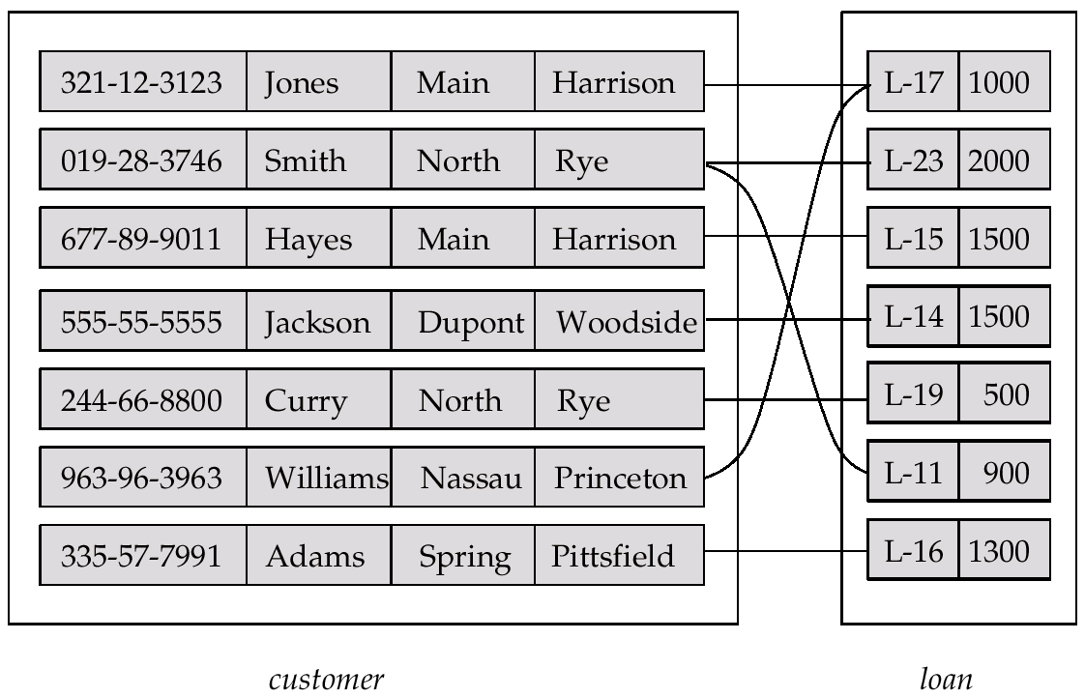
Relationship Types and Sets

Slide 105
Relationship Types and Sets
The relationship can be described by certain characteristics.
Degree of the relationship.
Role.
Recursive Relationship.
Cardinality.
Participation Constraint.

Slide 106
Relationship Types and Sets
Degree of The Relationship
The total number of entities participating in the relation is called degree of the Relationship.
1.Unary Relationship.
2. Binary Relationship.
3. Ternary Relationship.

Slide 107
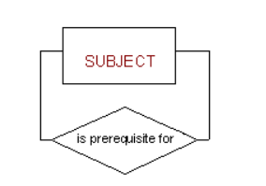
Relationship Types and Sets
Unary Relationship
When there is a relationship between two entities of the same type, it is known as a unary or recursive relationship. This means that the relationship is between different instances of the same entity type.
When both participants in the relationship are the same entity.
Ex: Subjects may be prerequisites for other subjects

Slide 108
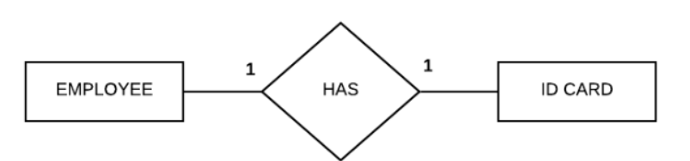
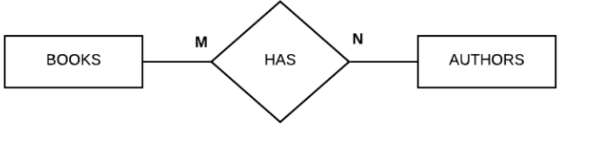
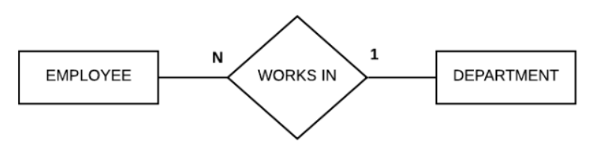
Relationship Types and Sets
Binary Relationship
When there is a relationship between two different entities, it is known as a binary relationship.

Slide 109
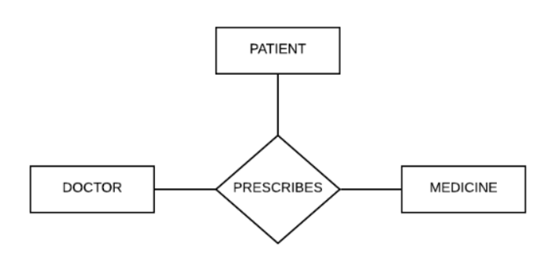
Relationship Types and Sets
Ternary Relationship
When there is a relationship between three different entities, it is known as a ternary relationship. An example of a ternary relationship can be shown as follows

Slide 110
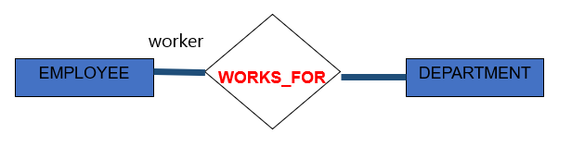
Relationship Types and Sets
Role
Role is the function an entity plays in the relationship.
Roles are optional.
They help in clarifying the semantics of a relationship.
EMPLOYEE entity is playing the role of worker.

Slide 111
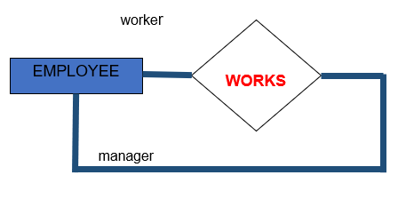
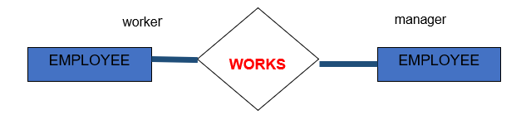
Relationship Types and Sets
Recursive Relationship
When the relationship occurs within the same entity.it is called Recursive Relationship.
An entity related to itself is the recursive relationship.
The same entity performs different roles.
EMPLOYEE entity is playing the role of worker.
EMPLOYEE entity is playing the role of manager.

Slide 112
Mapping Cardinalities
The number of instances of an entity in the entity set related with the number of instances of another entity in its entity set through a relationship set is called Cardinality ratio.
Express the number of entities to which another entity can be associated via a relationship set.
Most useful in describing binary relationship sets.

Slide 113
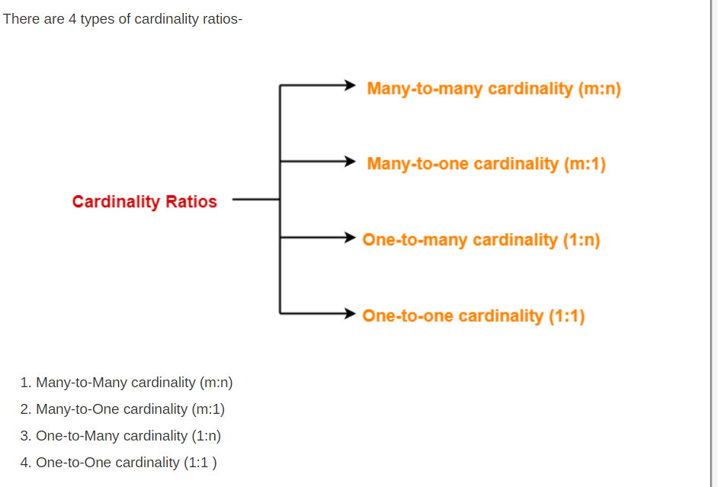
Cardinality Ratios

Slide 114
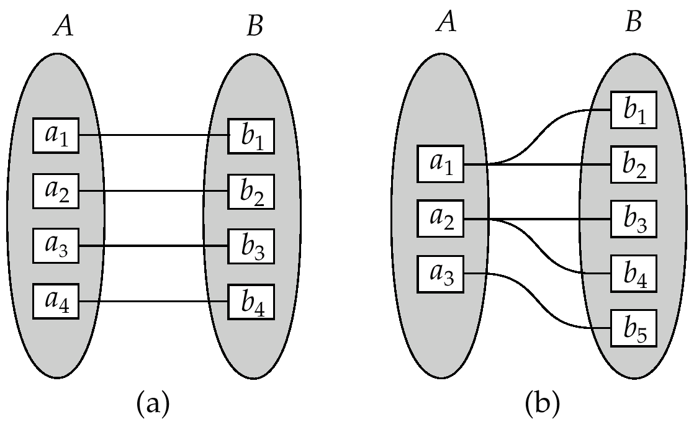
Mapping Cardinalities
One to one
One to many

Slide 115
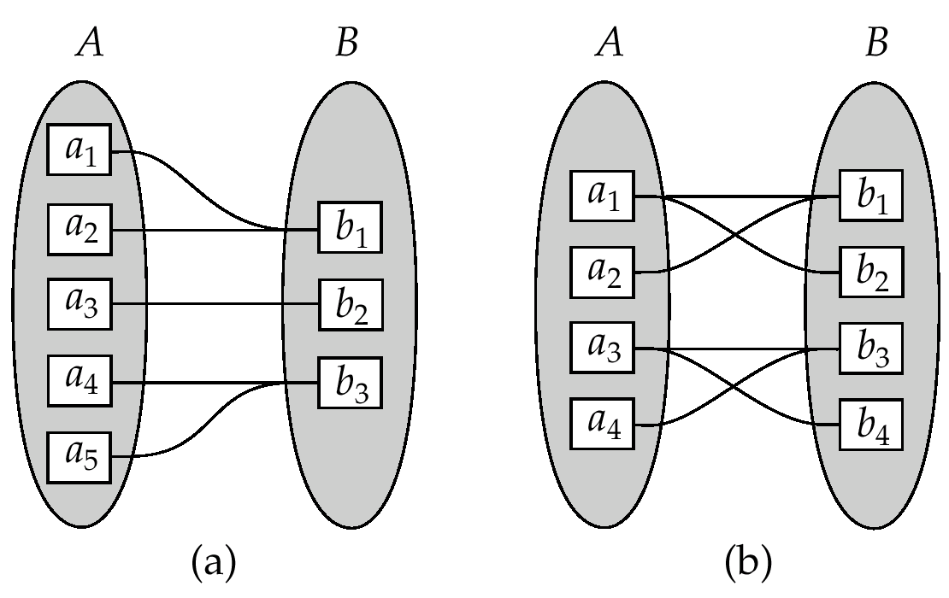
Mapping Cardinalities
Many to one
Many to many

Slide 116
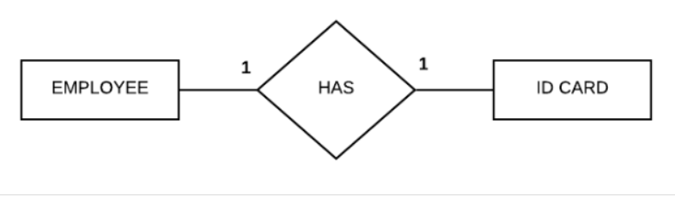
Cardinality Ratio
One to One (1:1) : one instance of an entity is related with one instance of another entity is called One-to-One relationship.
Cardinality ratio is 1:1

Slide 117

Cardinality Ratio
One to Many (1:M) : one instance of an entity is related with many instance of another entity is called One-to-Many relationship.
Cardinality ratio is 1:M

Slide 118
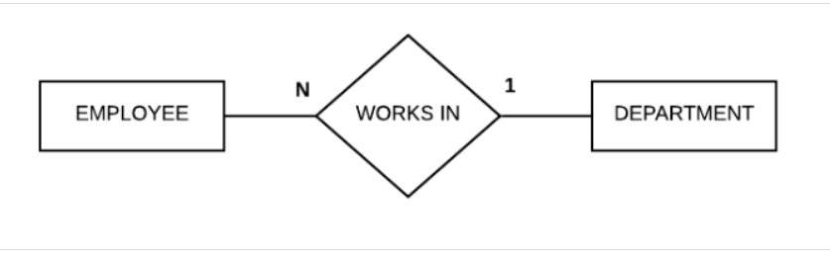
Cardinality Ratio
Many to One (N:1) : Many instances of an entity is related with one instance of another entity is called Many-to-One relationship.
Cardinality ratio is N:1

Slide 119
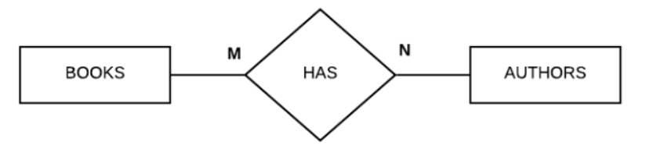
Cardinality Ratio
Many to Many (M:N) : Many instances of an entity is related with Many instances of another entity is called Many-to-Many relationship.
Cardinality ratio is M:N

Slide 120
Participation Constraint
Participation Constraint : Participation Constraint describe the participation of an entity in the relationship set.
Participation is of Two Types
Total Participation
Partial Participation
Total Participation − Each entity is involved in the relationship. Total participation is represented by double lines.
Partial participation − Not all entities are involved in the relationship. Partial participation is represented by single lines.

Slide 121
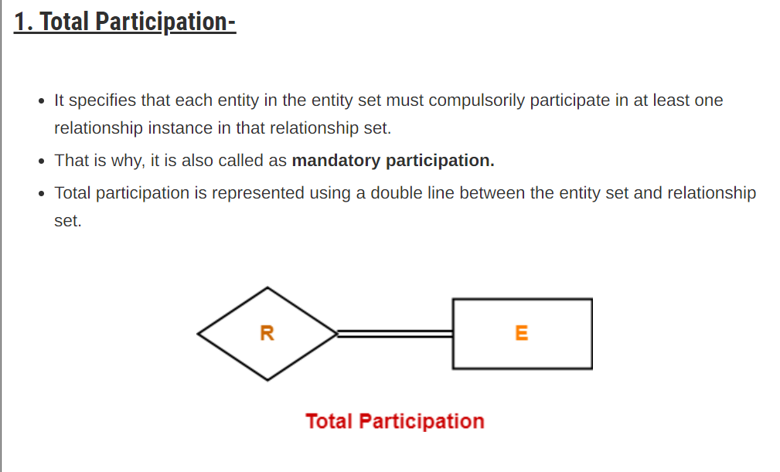

Slide 122

Double line between the entity set “Student” and relationship set “Enrolled in” signifies total participation.
It specifies that each student must be enrolled in at least one course.

Slide 123


Slide 124

Single line between the entity set “Course” and relationship set “Enrolled in” signifies partial participation.
It specifies that there might exist some courses for which no enrollments are made.

Slide 125
Structural Constraints
cardinality ratio and participation constraints, taken together, as the structural constraints of a relationship type.

Slide 126


Notations of ER Diagram

Slide 127


ER Diagram
The CAR entity type with two key attributes, Registration and Vehicle_id. (a) ER diagram notation. (b) Entity set with three entities.

Slide 128


ER Diagram
Preliminary design of entity types for the COMPANY database. Some of the shown attributes will be refined into relationships.

Slide 129

ER Diagram

Slide 130

ER diagrams for the company schema, with structural constraints specified using (min, max) notation and role names.

Slide 131
Weak Entity Types
An entity that does not have a key attribute and that is identification- dependent on another entity type.
A weak entity must participate in an identifying relationship type with an owner or identifying entity type
Entities are identified by the combination of:
A partial key of the weak entity type
The particular entity they are related to in the identifying relationship type
Example:
A DEPENDENT entity is identified by the dependent’s first name, and the specific EMPLOYEE with whom the dependent is related
Name of DEPENDENT is the partial key
DEPENDENT is a weak entity type
EMPLOYEE is its identifying entity type via the identifying relationship type DEPENDENT_OF

Slide 132
Practice
Library Management System
Entity Identification:
Draw an ER diagram for a Library Management System. Identify the main entities and their attributes.
Relationships:
Establish relationships between entities such as "Book," "Author," and "Borrower" in the context of a Library Management System.
Attributes and Keys:
Define the attributes for entities like "Book" and determine the primary key for each entity.
Cardinality and Participation Constraints:
Specify the cardinality and participation constraints for relationships like "Borrower borrows Book" and "Book written by Author."

Slide 133
Practice
Hospital Management System:
Entity Identification:
Draw an ER diagram for a Hospital Management System. Identify the main entities, such as "Patient," "Doctor," and "Appointment," along with their attributes.
Relationships:
Establish relationships between entities in the context of a Hospital Management System, considering connections like "Patient is treated by Doctor" and "Appointment scheduled for Patient."
Attributes and Keys:
Define the attributes for entities like "Patient" and determine the primary key for each entity in the Hospital Management System.
Cardinality and Participation Constraints:
Specify the cardinality and participation constraints for relationships like "Doctor treats Patient" and "Patient has multiple Appointments."

Slide 134
Practice
Online Shopping System:
Entity Identification:
Draw an ER diagram for an Online Shopping System. Identify the main entities, such as "Customer," "Product," and "Order," along with their attributes.
Relationships:
Establish relationships between entities in the context of an Online Shopping System, considering connections like "Customer places Order" and "Product is part of Order."
Attributes and Keys:
Define the attributes for entities like "Product" and determine the primary key for each entity in the Online Shopping System.
Cardinality and Participation Constraints:
Specify the cardinality and participation constraints for relationships like "Customer places multiple Orders" and "Order contains multiple Products."

Slide 135


